Slide 1
Software Design
Unit-III

Slide 2
Abstraction
Modularity
Software Architecture
Cohesion
Coupling
Real time and distributed system design
Documentation
Data flow orientated design
Designing for reuse.
Programming standards

Slide 3
Software Design
Software design is a mechanism to transform user requirements into some suitable form, which helps the programmer in software coding and implementation.
It deals with representing the client's requirement, as described in SRS (Software Requirement Specification) document, into a form, i.e., easily implementable using programming language.
The software design phase is the first step in SDLC (Software Design Life Cycle), which moves the concentration from the problem domain to the solution domain.
In software design, we consider the system to be a set of components or modules with clearly defined behaviors & boundaries.

Slide 4
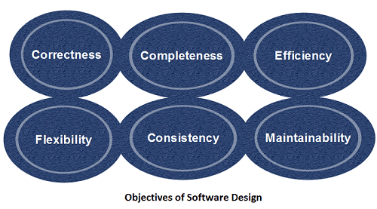
Objectives of Software Design

Slide 5
Correctness: Software design should be correct as per requirement.
Completeness: The design should have all components like data structures, modules, and external interfaces, etc.
Efficiency: Resources should be used efficiently by the program.
Flexibility: Able to modify on changing needs.
Consistency: There should not be any inconsistency in the design.
Maintainability: The design should be so simple so that it can be easily maintainable by other designers.

Slide 6
What Is Abstraction?
Abstraction is one of the fundamental concepts of software engineering.
It is all about hiding complexity in building various parts of your application.
An abstraction is a tool that enables a designer to consider a component at an abstract level without bothering about the internal details of the implementation. Abstraction can be used for existing element as well as the component being designed.
Example Of Abstraction:
Printing a document from your computer. You just open the document, click on the “print” command, and in a short while, the printed document is ready. You are not really bothered about how the computer stores the document in 0s and 1s, nor about how it is transferred to the printer.
A car is a very complex machine but the interface is simple (a steering wheel, a gas pedal and a gear shift)
A video game controller only has a few buttons, but underneath the controller is complex control mechanism
A programming language can be fairly simple, but it translates the instructions you write into machine code, which is impossibly complex

Slide 7
why abstraction is required?
You must decide at what level should I abstract a problem and solution. Abstraction is required because life is complex. We need to simplify complex systems so people can understand and use them.
For example, a student is building a software program to help students pick the right college. The student uses NEET scores to determine a good match. The student has abstracted complexity when it comes to choosing a college. There are actually many factors in choosing a college, but the student has chosen to focus on NEET scores.
Abstraction Levels:
Procedural Abstraction
Data Abstraction
Control Abstraction

Slide 8
The various levels of abstraction are as follows:
● Procedural Abstraction: It is a sequence of instructions that have limited functions in a specific area. E.g. the word “prepare” for tea. Although it involves a lot of actions like going to the kitchen, boiling water in the kettle, adding tea leaves, sugar and milk, removing the kettle from the gas stove and finally putting the gas off.
● Data Abstraction: It is a named collection of data that describes the data object. E.g. data abstraction for prepare tea will used kettle as a data object which in turn would contain a number of attributes like brand, weight, colour, etc.
● Control Abstraction: It implies a program control mechanism without specifying its internal details for example, synchronisation semaphore in operating system which is used for coordination amongst various activities.

Slide 9
Modularity
Modularity specifies to the division of software into separate modules which are differently named and addressed and are integrated later on in to obtain the completely functional software. It is the only property that allows a program to be intellectually manageable. Single large programs are difficult to understand and read due to a large number of reference variables, control paths, global variables, etc.
The desirable properties of a modular system are:
Each module is a well-defined system that can be used with other applications.
Each module has single specified objectives.
Modules can be separately compiled and saved in the library.
Modules should be easier to use than to build.
Modules are simpler from outside than inside.

Slide 10
Advantages and Disadvantages of Modularity
It allows large programs to be written by several or different people
It encourages the creation of commonly used routines to be placed in the library and used by other programs.
It simplifies the overlay procedure of loading a large program into main storage.
It provides more checkpoints to measure progress.
It provides a framework for complete testing, more accessible to test
It produced the well designed and more readable program.
Disadvantages of Modularity
Execution time maybe, but not certainly, longer
Storage size perhaps, but is not certainly, increased
Compilation and loading time may be longer
Inter-module communication problems may be increased
More linkage required, run-time may be longer, more source lines must be written, and more documentation has to be done

Slide 11
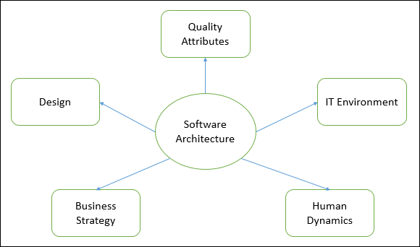
Software Architecture
Architecture serves as a blueprint for a system.
It provides an abstraction to manage the system complexity and establish a communication and coordination mechanism among components.

Slide 12
The architecture of a system describes its major components, their relationships (structures), and how they interact with each other.
It defines a structured solution to meet all the technical and operational requirements, while optimizing the common quality attributes like performance and security.
Further, it involves a set of significant decisions about the organization related to software development and each of these decisions can have a considerable impact on quality, maintainability, performance, and the overall success of the final product.
Goals of Architecture:
The primary goal of the architecture is to identify requirements that affect the structure of the application.
A well-laid architecture reduces the business risks associated with building a technical solution and builds a bridge between business and technical requirements.

Slide 13
Expose the structure of the system, but hide its implementation details.
Realize all the use-cases and scenarios.
Try to address the requirements of various stakeholders.
Handle both functional and quality requirements.
Reduce the goal of ownership and improve the organization’s market position.
Improve quality and functionality offered by the system.
Improve external confidence in either the organization or system.

Slide 14
Limitations
Software architecture is still an emerging discipline within software engineering. It has the following limitations −
Lack of tools and standardized ways to represent architecture.
Lack of analysis methods to predict whether architecture will result in an implementation that meets the requirements.
Lack of awareness of the importance of architectural design to software development.
Lack of understanding of the role of software architect and poor communication among stakeholders.
Lack of understanding of the design process, design experience and evaluation of design.

Slide 15
Cohesion
In computer programming, cohesion defines to the degree to which the elements of a module belong together.
Thus, cohesion measures the strength of relationships between pieces of functionality within a given module.
For example, in highly cohesive systems, functionality is strongly related.
Cohesion is an ordinal type of measurement and is generally described as "high cohesion" or "low cohesion.“
A good software design will have high cohesion

Slide 16
High cohesion : In a good module, various parts having high cohesion is preferable due to reliability, reusability, robustness, understanbility.
Low Cohesion : associate with undesirable traits including difficult is maintaining, reusing and understanding.

Slide 17
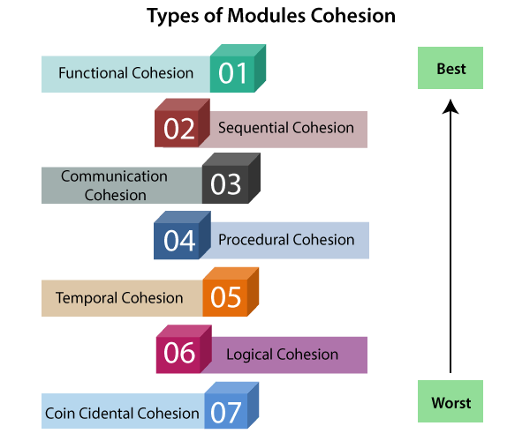
Types of Cohesion

Slide 18
Coupling
In software engineering, the coupling is the degree of interdependence between software modules.
Two modules that are tightly coupled are strongly dependent on each other. However, two modules that are loosely coupled are not dependent on each other.
Uncoupled modules have no interdependence at all within them.

Slide 19
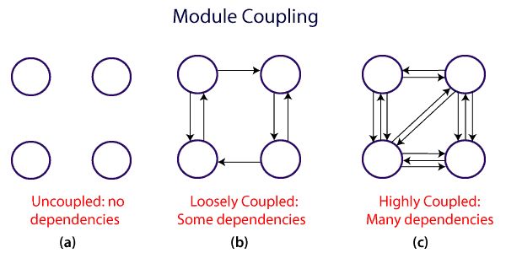
The various types of coupling techniques

Slide 20
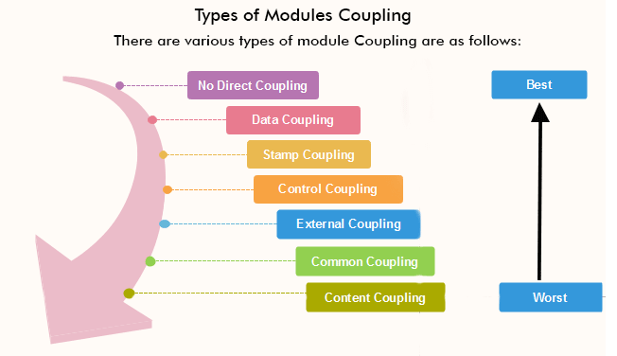

Slide 21
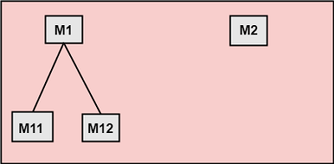
1. No Direct Coupling: There is no direct coupling between M1 and M2.
In this case, modules are subordinates to different modules. Therefore, no direct coupling.

Slide 22
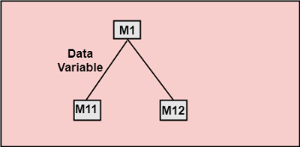
2. Data Coupling: When data of one module is passed to another module, this is called data coupling.

Slide 23
3. Stamp Coupling: Two modules are stamp coupled if they communicate using composite data items such as structure, objects, etc. When the module passes non-global data structure or entire structure to another module, they are said to be stamp coupled. For example, passing structure variable in C or object in C++ language to a module.
Multiple modules share common data structure and work on different part of it.
4. Control Coupling: Control Coupling exists among two modules if data from one module is used to direct the structure of instruction execution in another.
5. External Coupling: External Coupling arises when two modules share an externally imposed data format, communication protocols, or device interface. This is related to communication to external tools and devices.

Slide 24
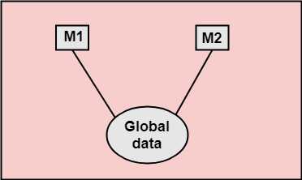
6. Common Coupling: Two modules are common coupled if they share information through some global data items.
7. Content Coupling: Content Coupling exists among two modules if they share code, e.g., a branch from one module into another module.

Slide 25
Difference b/w Coupling & Cohesion
Coupling | Cohesion
Coupling is also called Inter-Module Binding. | Cohesion is also called Intra-Module Binding.
Coupling shows the relationships between modules. | Cohesion shows the relationship within the module.
Coupling shows the relative independence between the modules. | Cohesion shows the module's relative functional strength.
While creating, you should aim for low coupling, i.e., dependency among modules should be less. | While creating you should aim for high cohesion, i.e., a cohesive component/ module focuses on a single function (i.e., single-mindedness) with little interaction with other modules of the system.
In coupling, modules are linked to the other modules. | In cohesion, the module focuses on a single thing.

Slide 26
Real time system
A real-time system means that the system is subjected to real-time, i.e., the response should be guaranteed within a specified timing constraint or the system should meet the specified deadline. For example flight control systems, real-time monitors, etc.
Real-time System: A real-time system is any system that responds in a timely manner.
Types of real-time systems based on timing constraints:
Hard real-time system: This type of system can never miss its deadline. Missing the deadline may have disastrous consequences. The usefulness of results produced by a hard real-time system decreases abruptly and may become negative if tardiness increases. Tardiness means how late a real-time system completes its task with respect to its deadline. Example: Flight controller system.
Soft real-time system: This type of system can miss its deadline occasionally with some acceptably low probability. Missing the deadline have no disastrous consequences. The usefulness of results produced by a soft real-time system decreases gradually with an increase in tardiness. Example: Telephone switches.

Slide 27
Distributed System
Distributed system a system in which components are distributed across multiple locations and computer-network.
Distributed System: A distributed system is an application that executes a collection of protocols to coordinate the actions of multiple processes on a network.

Slide 28
Advantages of Distributed system :
Economics: cost effective way to increase computing power.
Speed: a distributed system may have more total computing power than a mainframe.
Ex. 10,000 CPU chips, each running at 50 MIPS. Not possible to build 500,000 MIPS single processor since it would require 0.002 nsec instruction cycle.
Reliability: If one machine crashes, the system as a whole can still survive. Higher availability and improved reliability.
Incremental growth: Computing power can be added in small increments. Modular expandability
Data sharing: allow many users to access to a common data base
Resource Sharing: expensive peripherals like color printers
Communication: enhance human-to-human communication, e.g., email, chat
Flexibility: spread the workload over the available machines
Disadvantages of Distributed System :
Software: difficult to develop software for distributed systems
Network: saturation, lossy transmissions
Security: easy access also applies to secrete data

Slide 29
Documentation
Any written text, illustrations or video that describe a software or program to its users is called program or software document. User can be anyone from a programmer, system analyst and administrator to end user. At various stages of development multiple documents may be created for different users. In fact, software documentation is a critical process in the overall software development process.
In modular programming documentation becomes even more important because different modules of the software are developed by different teams. If anyone other than the development team wants to or needs to understand a module, good and detailed documentation will make the task easier.
These are some guidelines for creating the documents −
Documentation should be from the point of view of the reader
Document should be unambiguous
There should be no repetition
Industry standards should be used
Documents should always be updated
Any outdated document should be phased out after due recording of the phase out

Slide 30
Advantages
These are some of the advantages of providing program documentation −
Keeps track of all parts of a software or program
Maintenance is easier
Programmers other than the developer can understand all aspects of software
Improves overall quality of the software
Assists in user training
Ensures knowledge de-centralization, cutting costs and effort if people leave the system abruptly

Slide 31
Data flow orientated design
Data flow oriented design represents the flows of data between different processes and data structured design is considering about what information we should input and take as the output.
Data flow oriented-design approach is the one of the first comprehensive and well documented design method.
Data flow oriented design signifies the process of translating the DFDs to structure charts.
A Data Flow Diagram (DFD) is a traditional visual representation of the information flows within a system. A neat and clear DFD can depict the right amount of the system requirement graphically. It can be manual, automated, or a combination of both.
It shows how data enters and leaves the system, what changes the information, and where data is stored.
The objective of a DFD is to show the scope and boundaries of a system as a whole. It may be used as a communication tool between a system analyst and any person who plays a part in the order that acts as a starting point for redesigning a system. The DFD is also called as a data flow graph or bubble chart.

Slide 32
Structure Chart:
A structure chart is a graphical chart used for the purpose of describing and communicating a model or process within an organization.
This chart typically consists of shapes with descriptions and connecting lines that show relationships to other shapes within the chart.

Slide 33
Designing for reuse
Software engineering has been more concentrated on original development but it is now identified that to attain better software, more rapidly and at lower cost, it is needed to acquire a design process that is founded on systematic software reuse.
Reuse-based software engineering involves the following:
● Application system reuse: The entire of an application system may be reused either by including it without alteration into other systems or by creating application families.
● Component reuse: Components of an application from sub-systems to single objects may be reused.
● Object and function reuse: Software components that execute a single well-defined object or function may be reused.

Slide 34
Benefits of Software Reuse
Software reuse can decrease software development time and costs. The main benefits for software reuse are to:
● Produce better quality software and provide a powerful competitive advantage.
● Increase software productivity.
● Reduce software development and maintenance costs.
● Shorten software development time.
● Develop software with fewer people.
● Improve software system interoperability.
● Produce more standardised software.
● Move personnel more easily from project to project

Slide 35
Programming standards
Good software development organizations usually need their programmers to stick to some well-defined and standard style of coding known as coding standards.
Majority software development organizations create their own coding standards that suit them most, and need their engineers to pursue these standards thoroughly.
The aim of needing all engineers of an organization to stick to a standard style of coding is the following:
● A coding standard offers a uniform appearance to the codes written by various engineers.
● It improves code understanding.
● It motivates good programming practices.
A coding standard lists several rules to be pursued during coding, like the manner variables are to be named, the manner the code is to be laid out, error return conventions, etc.
Good software development organizations normally develop their own coding standards and guidelines relying on what best suit their organization and the kind of products they create.

Slide 36
The following are few representative coding standards:
● Rules for limiting the use of global: These rules list what kinds of data can be announced global and what cannot.
● Contents of the headers preceding codes for different modules: The information contained in the headers of various modules should be standard for an organization. The precise format in which the header information is arranged in the header can also be stated. The following are few standard header data:
❖ Name of the module.
❖ Date on which the module was created.
❖ Author’s name.
❖ Modification history.
❖ Synopsis of the module.
❖ Different functions supported, along with their input/output parameters.
❖ Global variables accessed/modified by the module.

Slide 37
Naming conventions for global variables, local variables, and constant identifiers: A probable naming convention can be that global variable names always begin with a capital letter, local variable names are comprised of small letters, and continuous names are always capital letters.
● Error return conventions and exception handling mechanisms: The way in which error conditions are reported by various functions in a program are tackled should be standard inside an organization.

